Slide 1
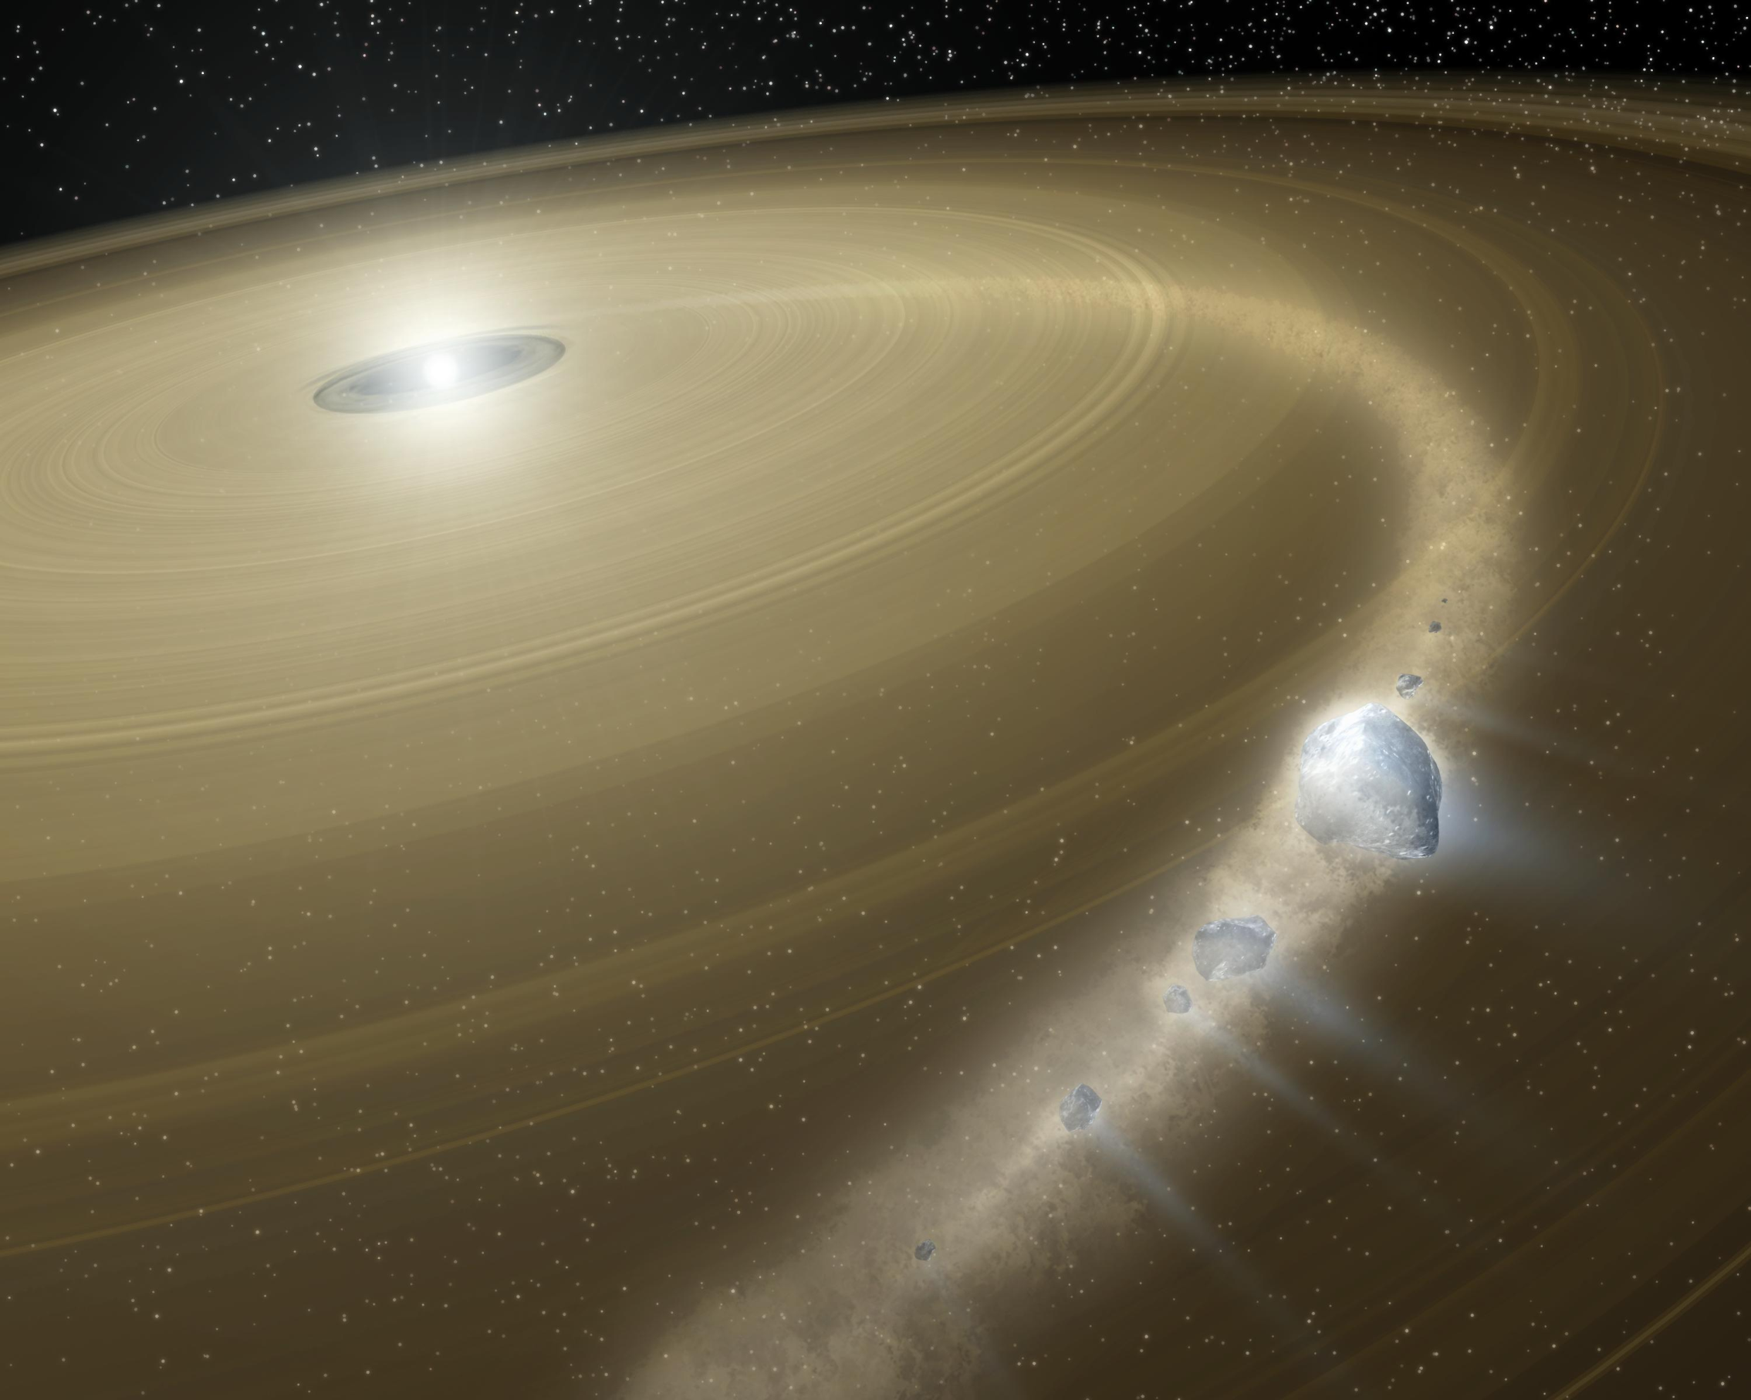


Gyrochronology: Aging Nearby, Debris Disk Candidate Stars
By : Christine Cunningham
Image Credit: NASA/JPL-Caltech

Slide 2
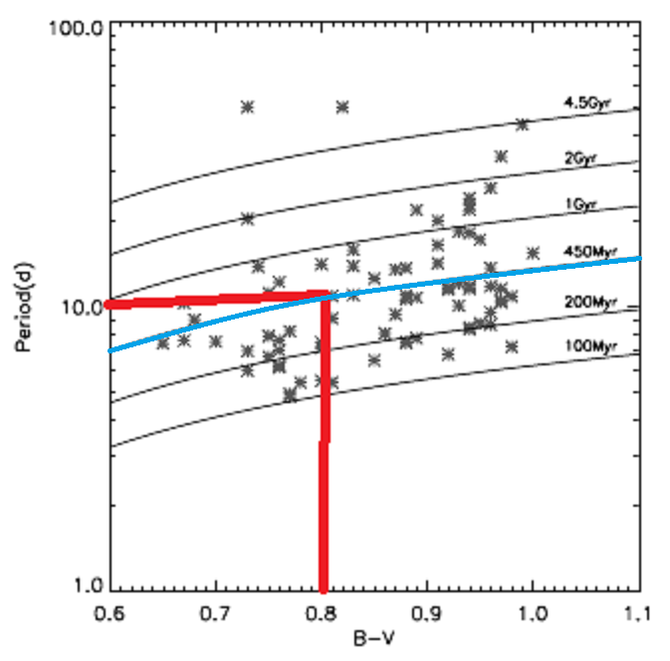
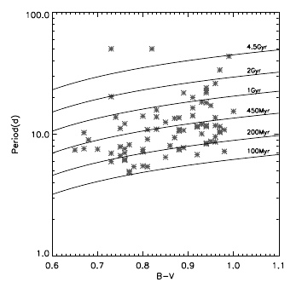
What is Gyrochronology
Gyrochronology – method of aging stars
Uses the rotation period of a star and color
Uses age graphs
The Astrophysical Journal, Volume 669, Issue 2, pp. 1167-1189.
Notes:
Gryrochronology is a method used to age stars based off two parameter, its rotation peroid, and its color or B-V magnitude. Here is an example graph of how a plot of the two parameters is used to determine its age. Now lets take for example, a star with a rotation period of 10 days and a B-V color of 0.8, since it falls along this blue line, it can be aged at approximately 450 Million years old.

Slide 3
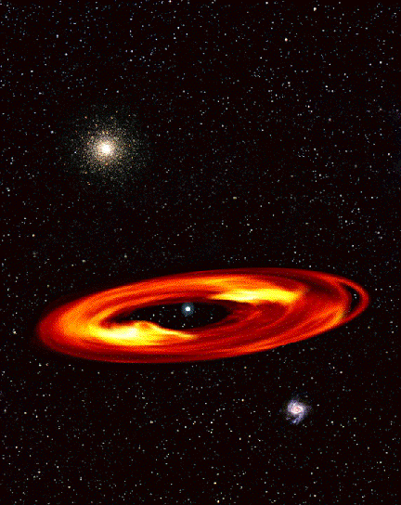
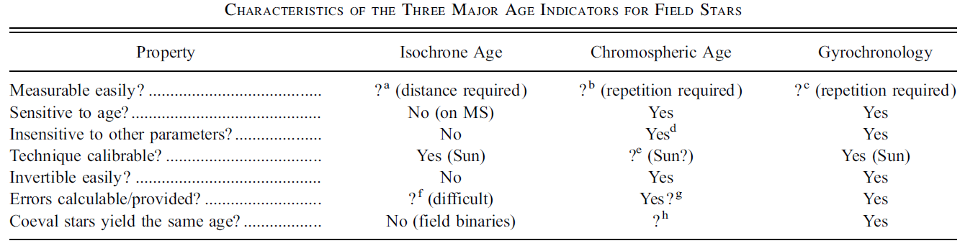
Why is it Useful
Aging method that doesn’t require clusters or chromospheric composition
-Conventional methods error 50%+
-Gyrochronology method error ~15-20%
Debris disks
The Astrophysical Journal, Volume 669, Issue 2, pp. 1167-1189.
Notes:
Gyrochronology is a new technique and is still being refined. Conventional methods use doppler shift (requires the star to have a small inclination), require the star to be a part of a cluster, or require chromospheric composition. Gyrochronology does not require either of these, making the process much simpler.
It is also useful in determining the age of stars with debris disks around them. Stars with debris disks tend to have less precision when using the above methods. Percentages of errors are around ~50% when using these methods. Gyrochronolgy bring these errors down to about 15-20% making the ages much more precise.

Slide 4
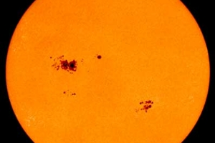
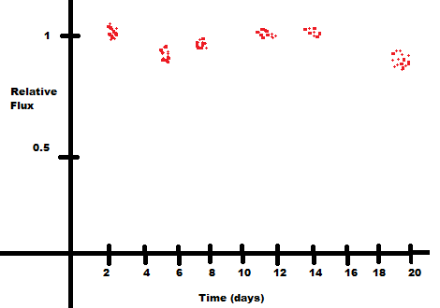
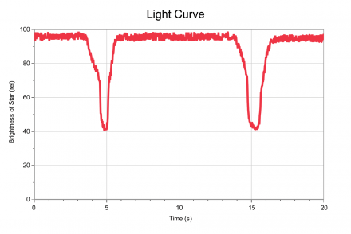
Rotation Period
Uses changes in flux from starspots to calculate the rotation from transits
Dips in flux can be seen in lightcurves
Using various methods a period can be obtained from the lightcurves

Slide 5
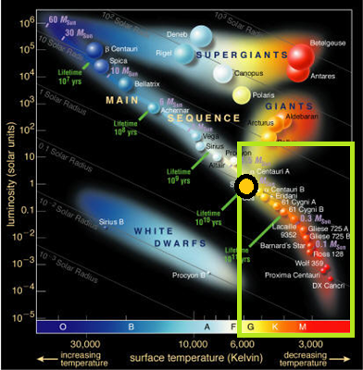
Survey Parameters
FGKM type stars (pic)
High apparent magnitude
Within 25 parsecs
Debris disk candidates
Certain RA and DEC
Image Credit : ESO

Slide 6
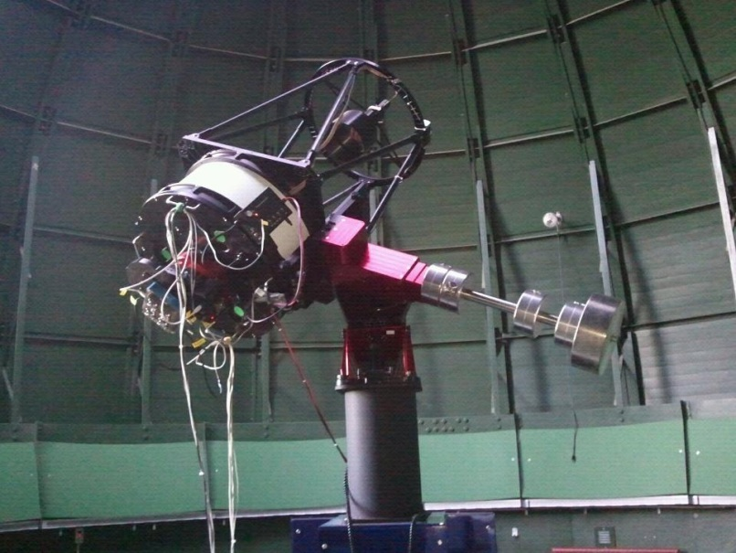
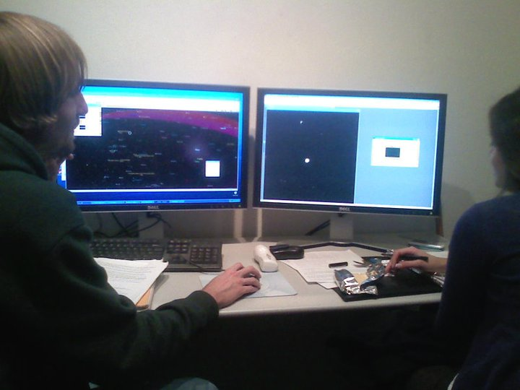
Collecting Photometric Data
Lutz 21” Telescope
ND filters
3-4 stars in a night, one hour each
Start with 3-4 nights a week, reduce to 2 nights, then to 1 night

Slide 7
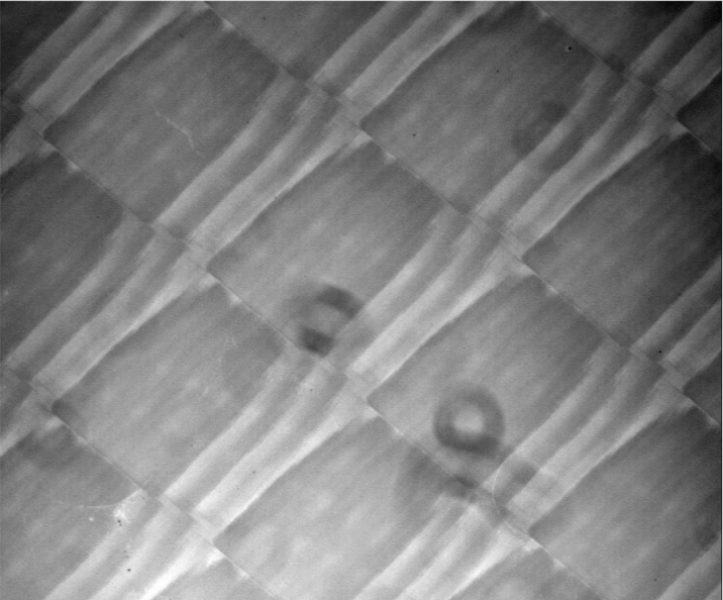
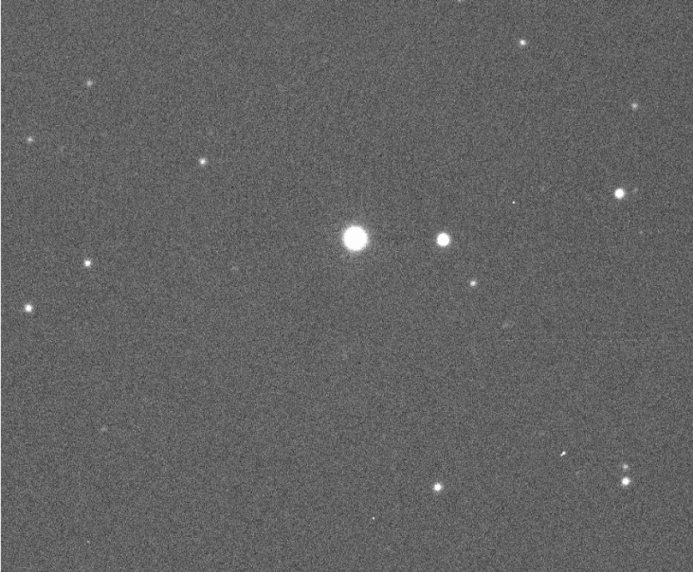
Data Reduction
Used the IRAF program on Linux
Flatfields
Alignment
Reference stars
Flux
Lightcurve

Slide 8
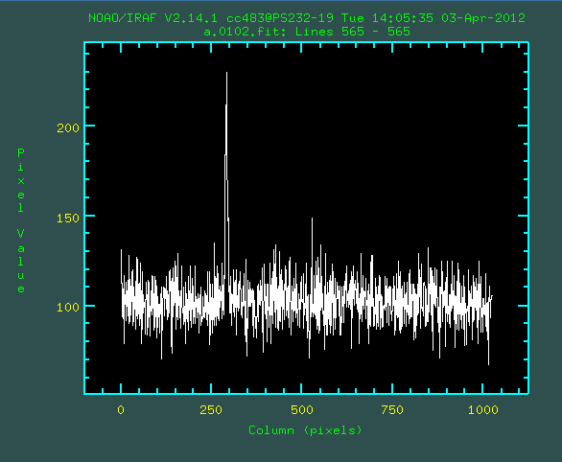
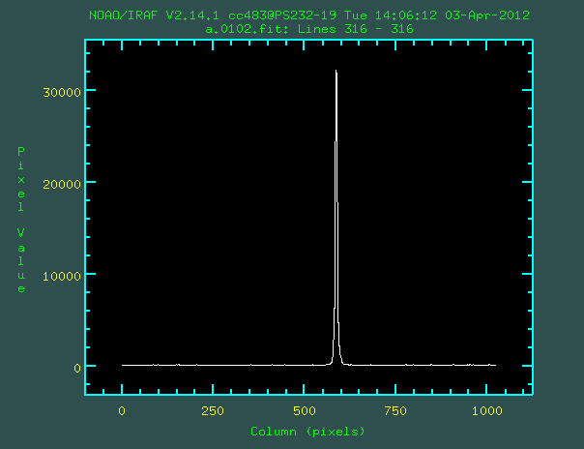
Reference Stars
Largest limitation
Relative photometry vs absolute photometry
Bright target star means short exposures
High signal to noise for reference stars
Notes:
Largest limitation, Relative photometry vs absolute photometry, Bright target star means short exposures, High signal to noise for reference stars

Slide 9
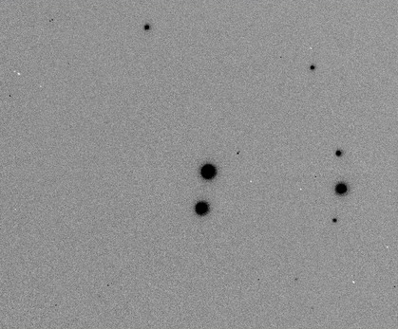
Observations
HIP 19859
Apparent Magnitude | Right Ascension | Declination | Distance
+ 6.32 | 4h 15m 29s | 6° 11’ 14’’ | 21.16 Pc

Slide 10
Results
No Finite Results
Accuracy of Lutz telescope good enough(?)
Signal to noise (?)
Bad reference stars (?)
Jeremy will talk about the light curve rotation rate results

Slide 11
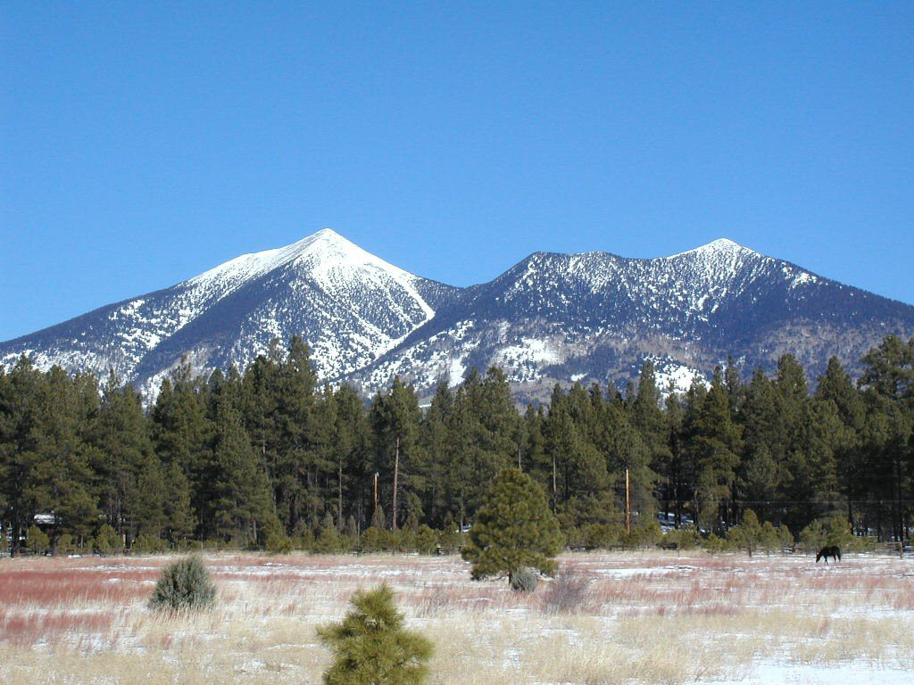
Thanks!
NASA Space Grant Program
Northern Arizona University
Dr. Koerner
Ms. Stigmon and Dr. Barlow

